Slide 1


Stroke Data Analysis - Group Assignment
Group 6

Slide 2
Objective
The groups' objective of this task is to perform data cleaning and exploratory data analysis (EDA) on the given dataset related to strokes.
Specific Objectives:
Identify Demographic Trends
Explore and analyze demographic factors such as age, gender, marital status, and residence type to identify any trends or patterns related to strokes.
Assess Health Metrics Impact
Investigate the impact of health metrics, including hypertension, heart disease, average glucose level, and BMI, on the occurrence of strokes.
Evaluate Lifestyle Factors
Examine lifestyle factors, specifically smoking status and work type, to understand their association with strokes.
Explore Correlations
Conduct correlation analysis to identify relationships between different health conditions (hypertension, heart disease) and understand their potential collective influence on strokes.

Slide 3
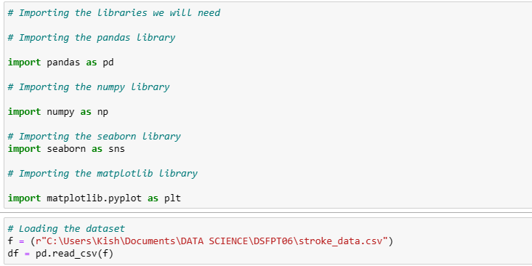
Data Loading Our first step included loading the data.

Slide 4
DATA INSPECTION

Slide 5
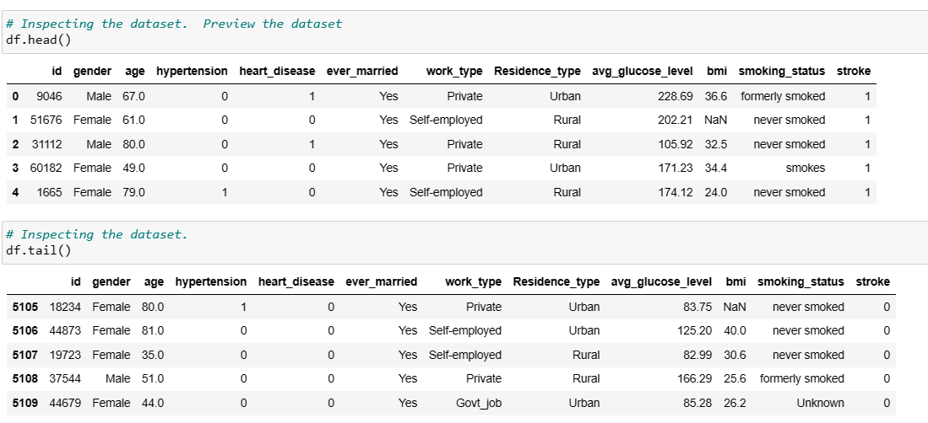
Preview rows of the dataset to get a sense of its shape and structure.
Check for the data types of each column and handle any inconsistencies.

Slide 6
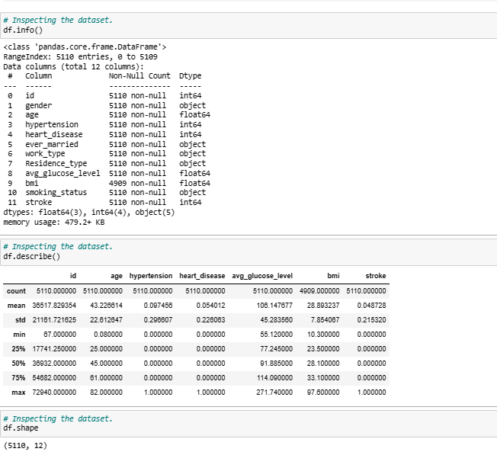
Data Inspection conti….

Slide 7
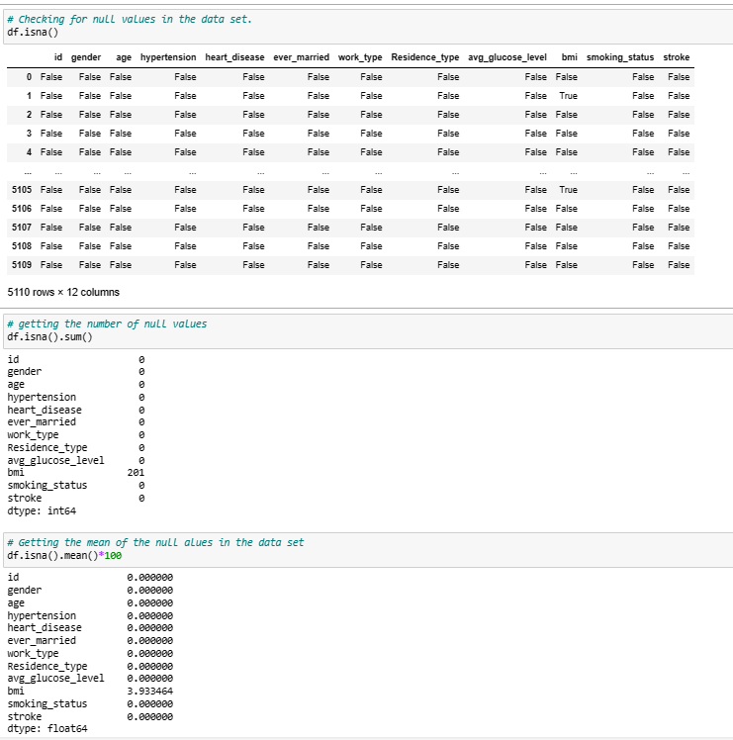
Check for missing values in each column

Slide 8
DATA CLEANING

Slide 9
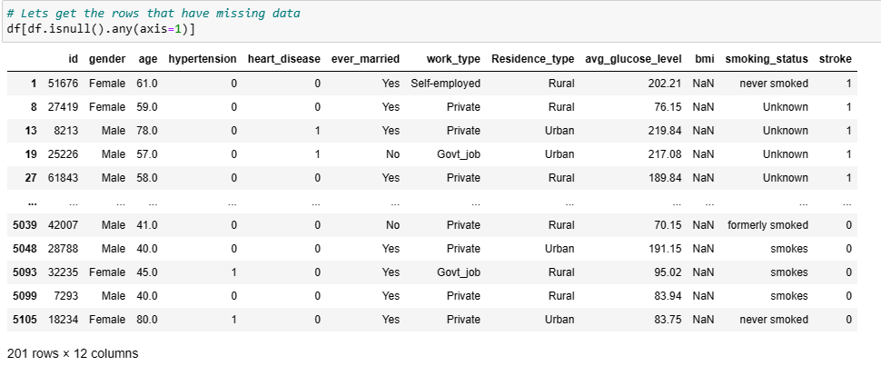
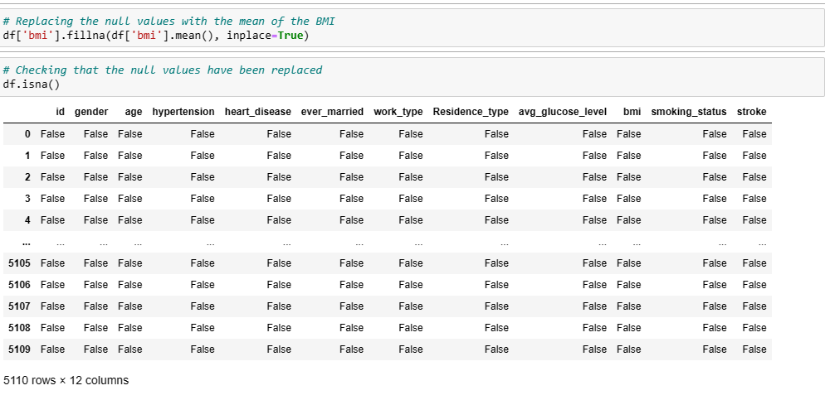
Replacing the null values with the mean of the BMI

Slide 10
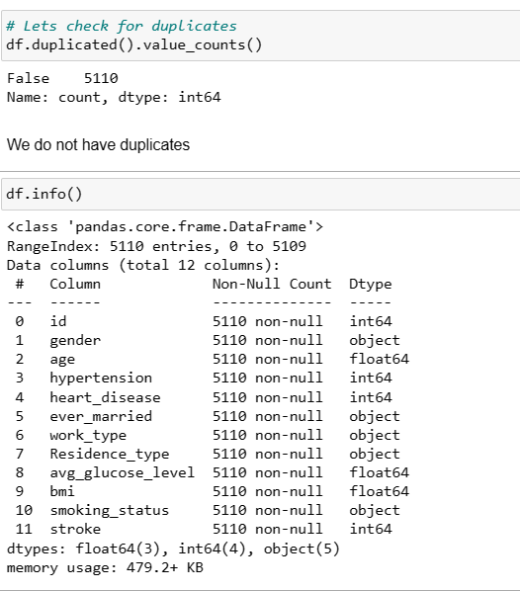

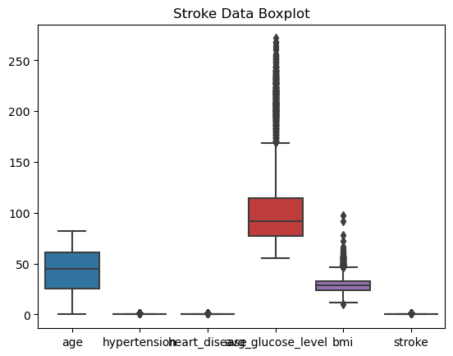
Check for and handle any duplicate rows and outliers
Note: We changed the data type id to string. (This data was not relevant in the analysis)

Slide 11
Exploratory Data Analysis (EDA):

Slide 12
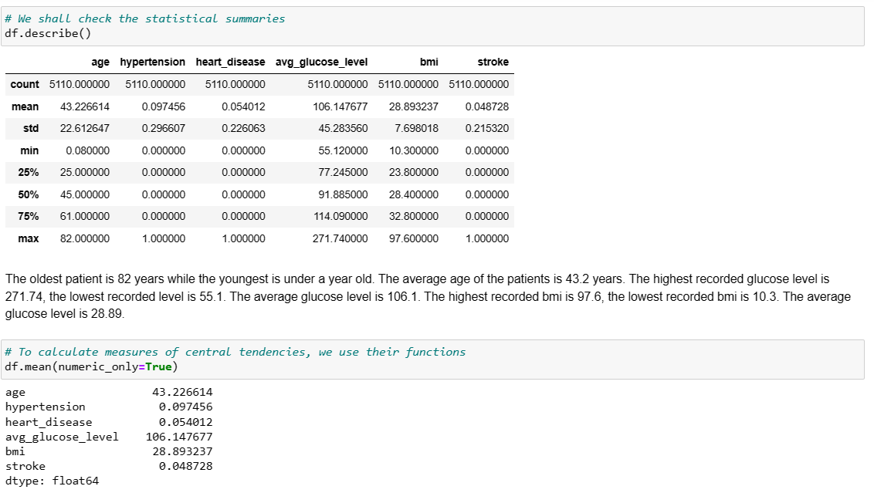
Statistical summaries

Slide 13
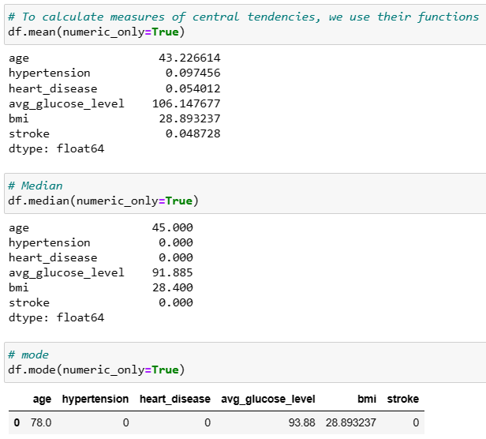
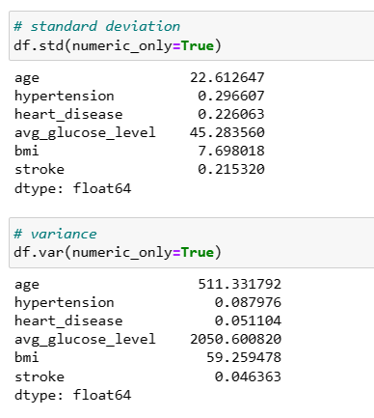
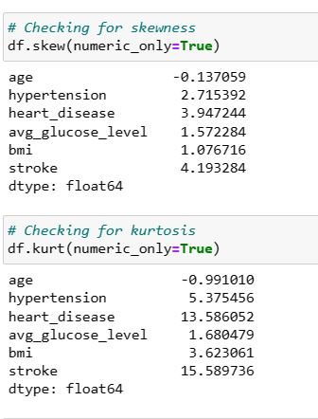
Generate descriptive statistics for numerical columns (mean, median, std, etc.)
Mean, Median and mode
Deviation and Variance
Skewness and Kurtosis

Slide 14
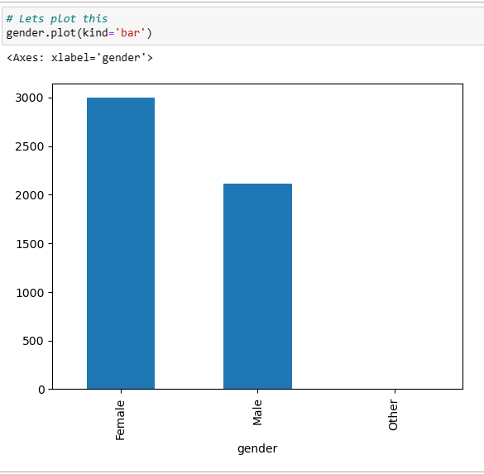
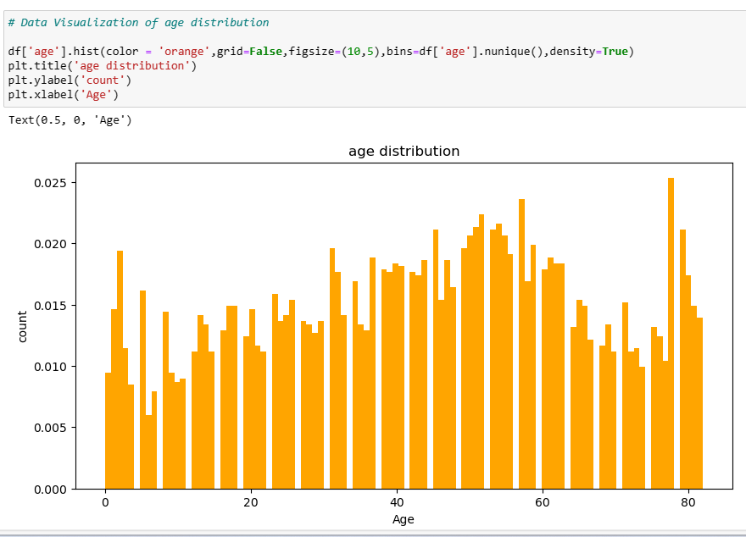
Data Visualization
Gender
Age

Slide 15
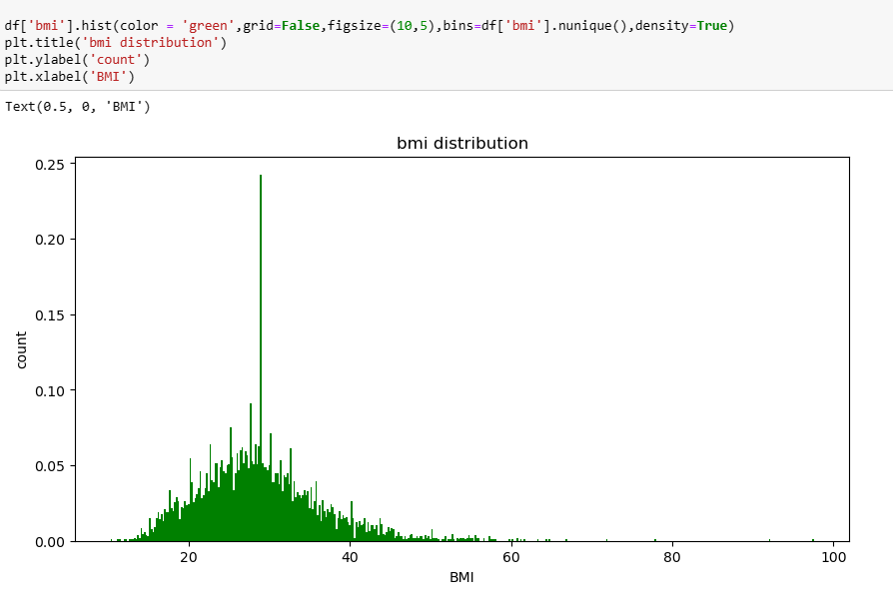
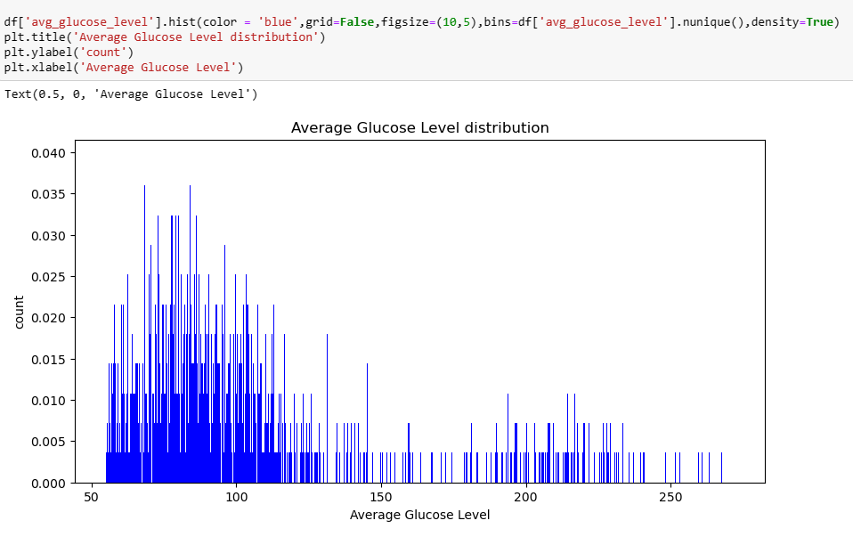
Data Visualization
Data Visualization of Average glucose levels distribution
BMI

Slide 16
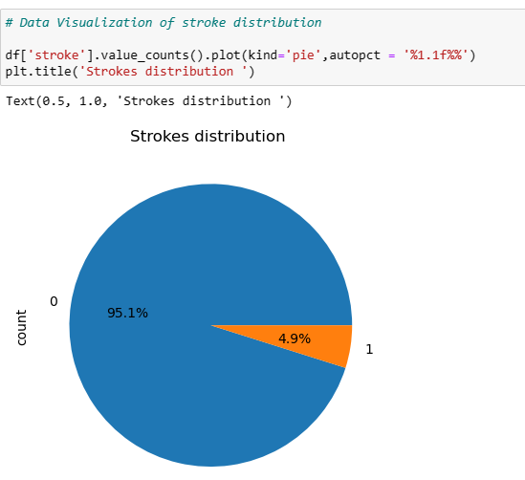
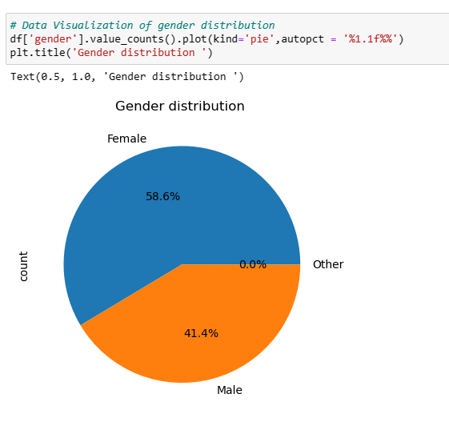
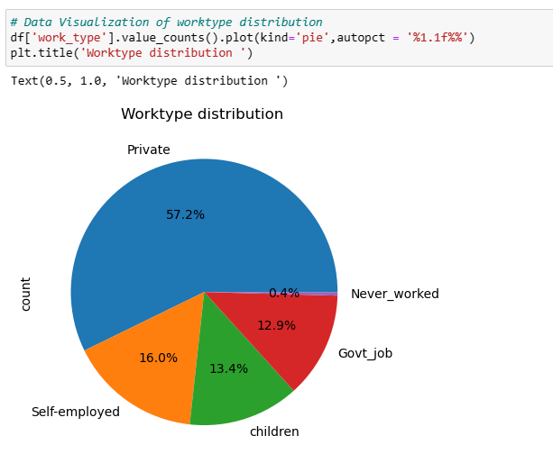
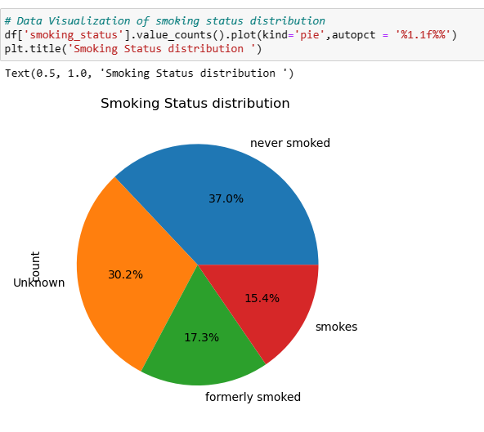
Distribution of gender, work type, and smoking status.

Slide 17
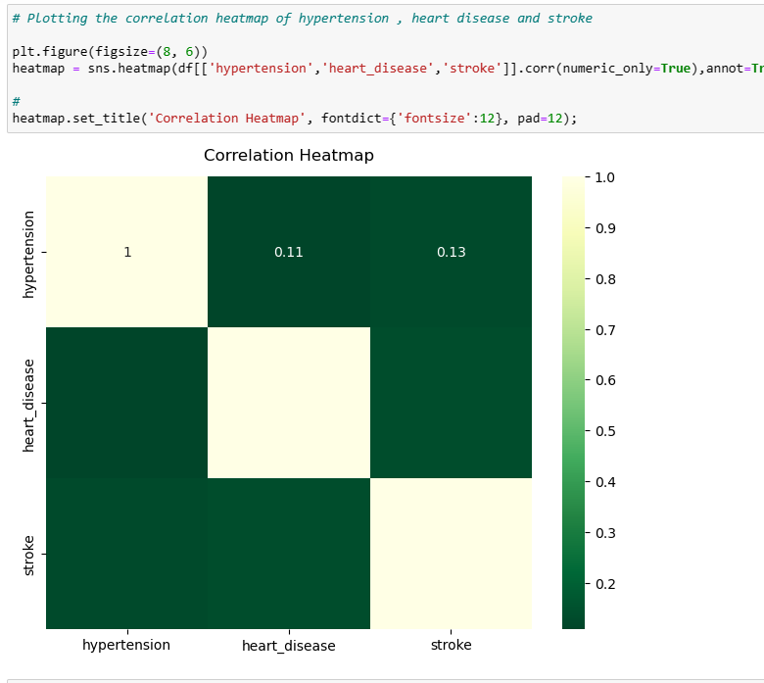
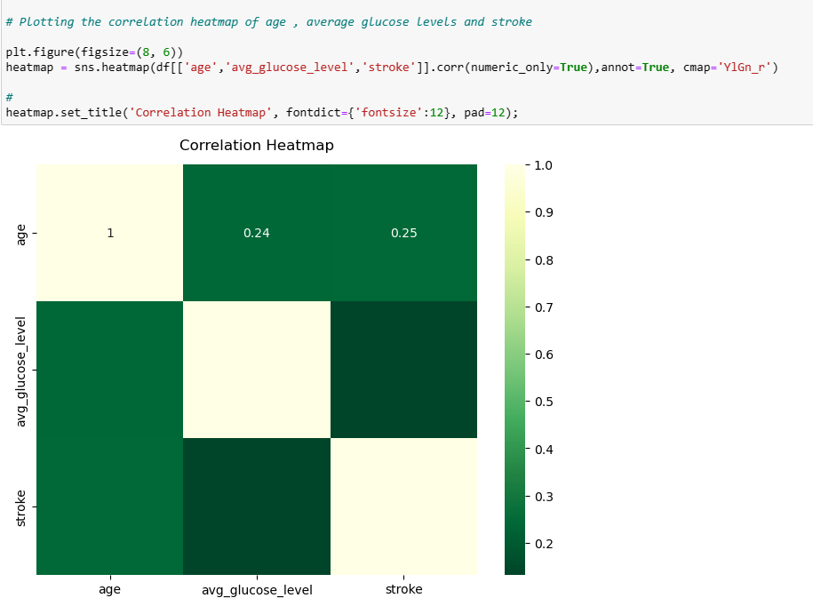
Correlation
Correlation heatmap

Slide 18
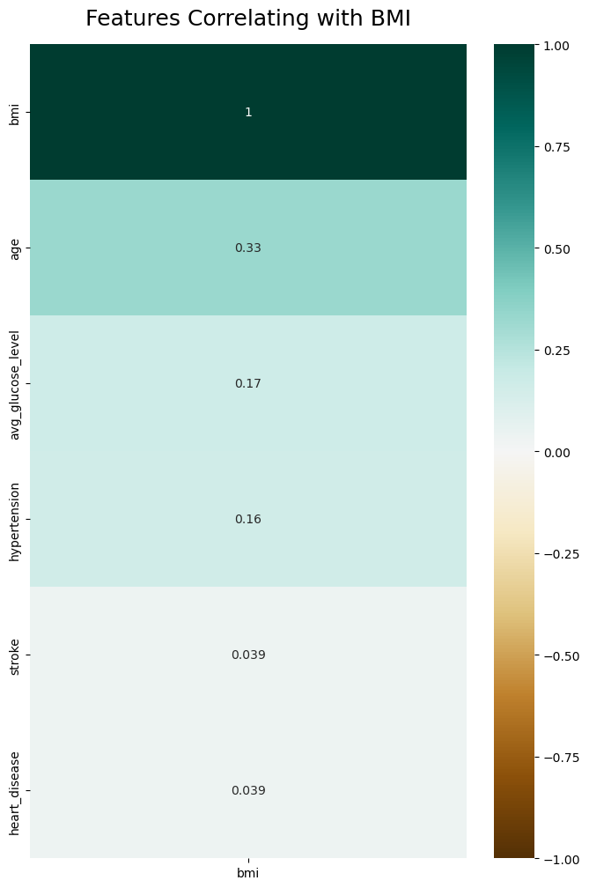
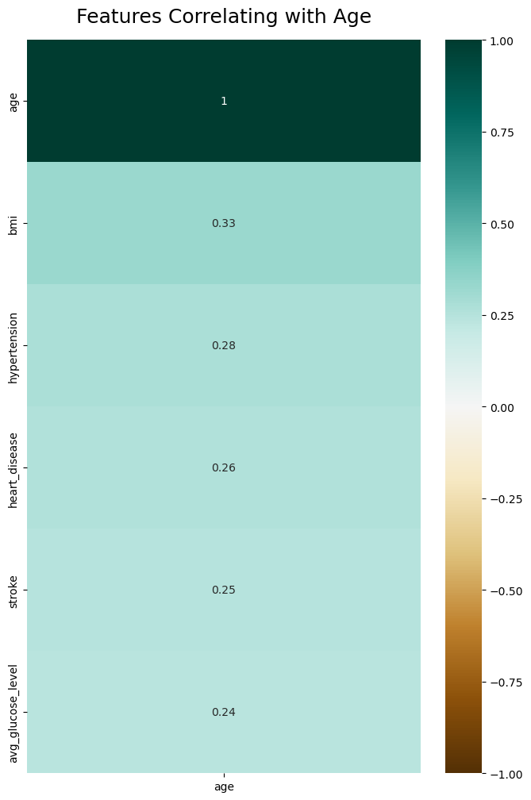
Correlation with BMI and age.

Slide 19
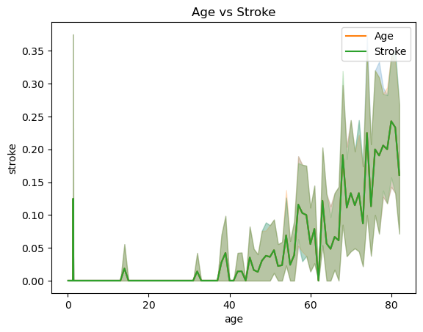
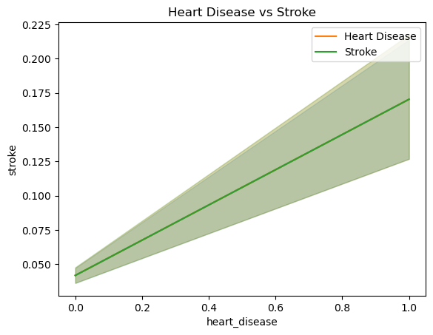
Patterns
Stroke and heart disease history of the patients are positively correlated. The patients with heart disease are more likely they are to suffer from stroke.
Stroke and age of the patients are positively correlated. The older the patient, the more likely they are to suffer from stroke.

Slide 20
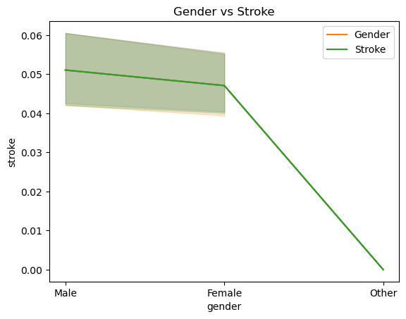
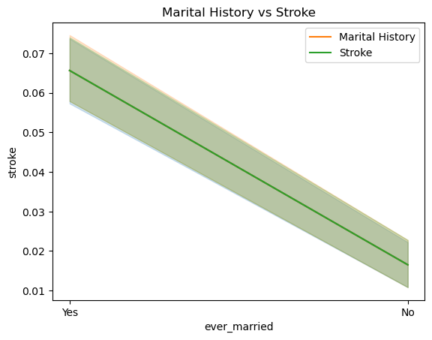
Stroke and the marital history of the patients are positively correlated. The patients who have ever been married are more likely to suffer from stroke.
Male patients are more likely to suffer a stroke compared to female patients with others having the lowest likelihood of suffering from stroke.

Slide 21
Patterns
Stroke and heart disease history of the patients are positively correlated. The patients with heart disease are more likely they are to suffer from stroke.
Stroke and age of the patients are positively correlated. The older the patient, the more likely they are to suffer from stroke.

Slide 22
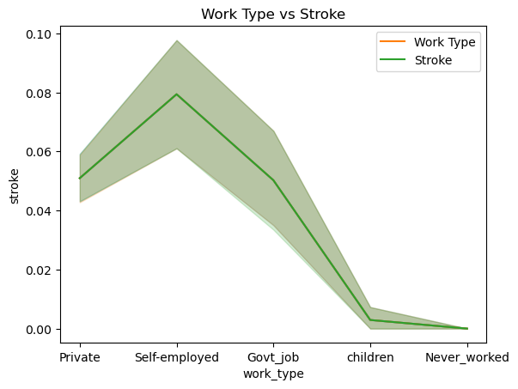
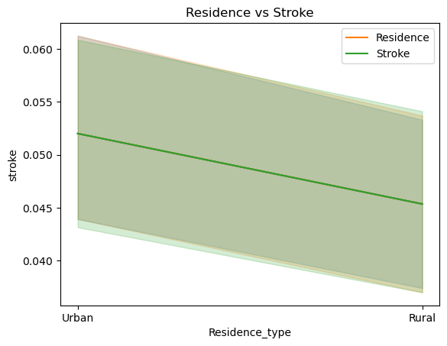
The self-employed patients have the highest likelihood of suffering from a stroke, followed by the patients working in the private sector and government jobs. The children and patients who have never worked before have the lowest likelihood of suffering a stroke. Self-employment is a risk factor in causing stroke.
Patients living in urban areas have a higher likelihood of suffering from a stroke as compared to patients living in rural areas. Living in urban areas is a risk factor for stroke

Slide 23
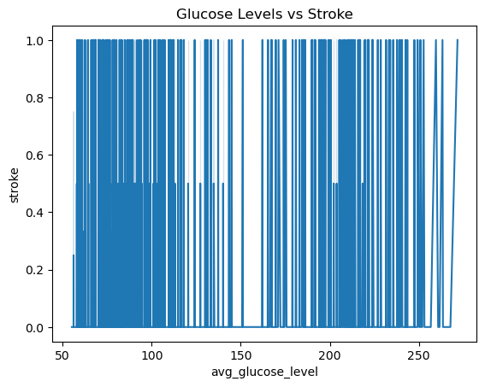
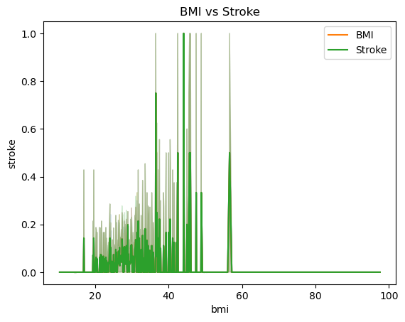
Glucose levels in the patients do not necessarily affect the likelihood of a stroke.
Patients with abnormal (higher) BMI levels are more likely to suffer a stroke as compared to patients with normal (lower) BMI levels. Higher BMI levels are a risk factor for stroke.

Slide 24
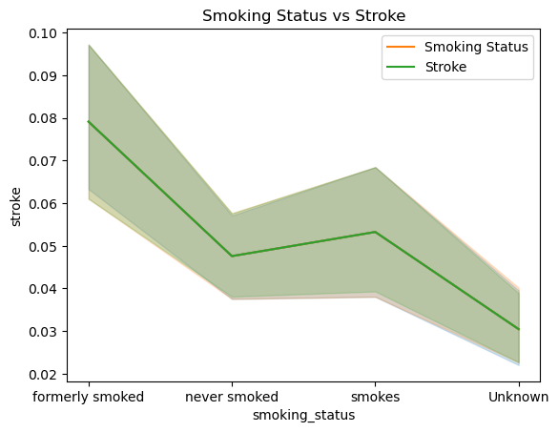
Patients who have formerly smoked have a higher likelihood of suffering from stroke. Patients who have never smoke and those who currently smoke have an equal likelihood of suffering from a stroke. The lowest likelihood of suffering stroke was observed in the patients whose smoking status was unknown. Smoking therefore is a risk factor in causing a stroke.

Slide 25
Summary and Insights

Slide 26
Summary and Insights
From our age variable, we see that only from 40 years old people start to have Stroke. Cases below 40 years are very rare. The older a person gets the higher the chances of getting a stroke.
When we look at our Glucose variable we can see that it is well distributed. Therefore, Glucose levels in the patients do not necessarily affect the likelihood of a stroke.
Diseases like diabetes, heart diseases and hypertension increase the chance of stroke. As a patient grows older it is observed that hypertension due to work-related stress may increase, also creating room for heart diseases
Patients with abnormal (higher) BMI levels are more likely to suffer a stroke as compared to patients with normal (lower) BMI levels. Higher BMI levels are a risk factor in causing stroke.
Patients who have formerly smoked have a higher likelihood of suffering from stroke. Patients who have never smoke and those that currently smoke have an equal likelihood of suffering from a stroke. The lowest likelihood of suffering stroke was observed from the patients whose smoking status was unknown. Smoking therefore is a risk factor in causing stroke.

Slide 27
Conti..
A major portion of the patients are women and it is observed that these patients have not suffered any stroke in the past.
As compared to males many female patients do not smoke. The probable reason is that the data captured have a majority of female records
Patients between the age of 0-18 do not suffer from any conditions, specifically hypertension and heart diseases
Children and patients who have never worked may not suffer from underlying conditions.

Slide 28
Thank You

